Slide 1
JAVA BOOTCAMP DAY 09
Presented by
G2Academy

Slide 2
Multithreading
Notes:
How presentation will benefit audience: Adult learners are more interested in a subject if they know how or why it is important to them.
Presenter’s level of expertise in the subject: Briefly state your credentials in this area, or explain why participants should listen to you.

Slide 3
Multithreading
Multithreading in java is a process of executing multiple threads simultaneously.
Thread is basically a lightweight sub-process, a smallest unit of processing. Multiprocessing and multithreading, both are used to achieve multitasking.
But we use multithreading than multiprocessing because threads share a common memory area. They don't allocate separate memory area so saves memory, and context-switching between the threads takes less time than process.
Notes:
Lesson descriptions should be brief.

Slide 4
Advantages of Multithreading
It doesn't block the user because threads are independent and you can perform multiple operations at same time.
You can perform many operations together so it saves time.
Threads are independent so it doesn't affect other threads if exception occur in a single thread.
Notes:
Lesson descriptions should be brief.

Slide 5
Multitasking
Multitasking is a process of executing multiple tasks simultaneously. We use multitasking to utilize the CPU. Multitasking can be achieved by two ways:
Process-based Multitasking(Multiprocessing)
Thread-based Multitasking(Multithreading)
Notes:
Lesson descriptions should be brief.

Slide 6
Process-based Multitasking (Multiprocessing)
Each process have its own address in memory i.e. each process allocates separate memory area.
Process is heavyweight.
Cost of communication between the process is high.
Switching from one process to another require some time for saving and loading registers, memory maps, updating lists etc.
Notes:
Lesson descriptions should be brief.

Slide 7
Thread-based Multitasking (Multithreading)
Threads share the same address space.
Thread is lightweight.
Cost of communication between the thread is low.
At least one process is required for each thread.
Notes:
Lesson descriptions should be brief.

Slide 8
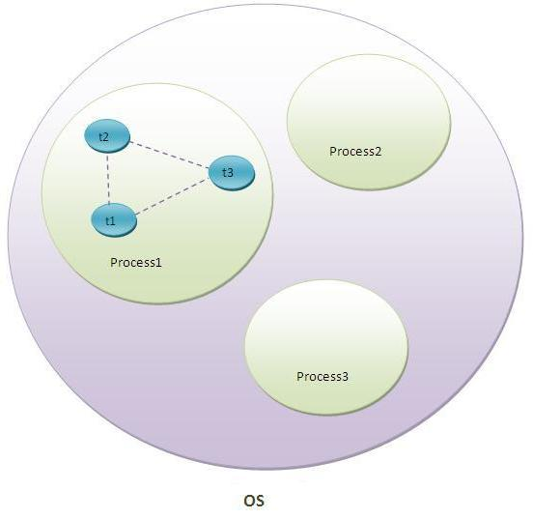
What is Thread
A thread is a lightweight sub process, a smallest unit of processing. It is a separate path of execution.
Threads are independent, if there occurs exception in one thread, it doesn't affect other threads. It shares a common memory area.
As shown in the side figure, thread is executed inside the process. There is context-switching between the threads.
There can be multiple processes inside the OS and one process can have multiple threads.
Notes:
Lesson descriptions should be brief.

Slide 9
Life cycle of a Thread
A thread can be in one of the five states. According to sun, there is only 4 states in thread life cycle in java new, runnable, non-runnable and terminated. There is no running state.
But for better understanding the threads, we are explaining it in the 5 states.
The life cycle of the thread in java is controlled by JVM. The java thread states are as follows.
New
Runnable
Running
Non-Runnable (Blocked)
Terminated
Notes:
Lesson descriptions should be brief.

Slide 10
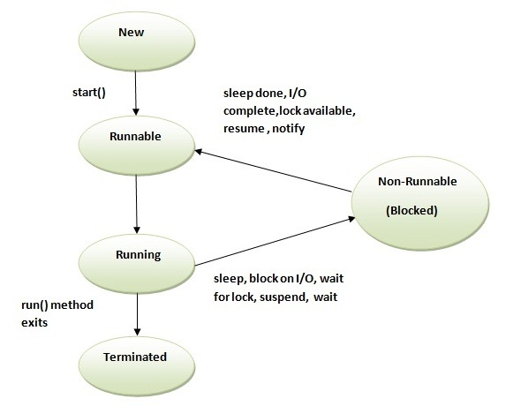
Life cycle of a Thread
Notes:
Lesson descriptions should be brief.

Slide 11
Life cycle of a Thread
New
The thread is in new state if you create an instance of Thread class but before the invocation of start() method.
Runnable
The thread is in runnable state after invocation of start() method, but the thread scheduler has not selected it to be the running thread.
Running
The thread is in running state if the thread scheduler has selected it.
Non-Runnable (Blocked)
This is the state when the thread is still alive, but is currently not eligible to run.
Terminated
A thread is in terminated or dead state when its run() method exits.
Notes:
Lesson descriptions should be brief.

Slide 12
How to create thread
There are two ways to create a thread:
By extending Thread class
By implementing Runnable interface.
Notes:
Lesson descriptions should be brief.

Slide 13
Thread class
Thread class provide constructors and methods to create and perform operations on a thread.Thread class extends Object class and implements Runnable interface.
Commonly used Constructors of Thread class:
Thread()
Thread(String name)
Thread(Runnable r)
Thread(Runnable r,String name)
Notes:
Lesson descriptions should be brief.

Slide 14
Commonly used methods of Thread class
public void run(): is used to perform action for a thread.
public void start(): starts the execution of the thread.JVM calls the run() method on the thread.
public void sleep(long miliseconds): Causes the currently executing thread to sleep (temporarily cease execution) for the specified number of milliseconds.
public void join(): waits for a thread to die.
public void join(long miliseconds): waits for a thread to die for the specified miliseconds.
public int getPriority(): returns the priority of the thread.
public int setPriority(int priority): changes the priority of the thread.
public String getName(): returns the name of the thread.
public void setName(String name): changes the name of the thread.
public Thread currentThread(): returns the reference of currently executing thread.
public int getId(): returns the id of the thread.
Notes:
Lesson descriptions should be brief.

Slide 15
Commonly used methods of Thread class
public Thread.State getState(): returns the state of the thread.
public boolean isAlive(): tests if the thread is alive.
public void yield(): causes the currently executing thread object to temporarily pause and allow other threads to execute.
public void suspend(): is used to suspend the thread(depricated).
public void resume(): is used to resume the suspended thread(depricated).
public void stop(): is used to stop the thread(depricated).
public boolean isDaemon(): tests if the thread is a daemon thread.
public void setDaemon(boolean b): marks the thread as daemon or user thread.
public void interrupt(): interrupts the thread.
public boolean isInterrupted(): tests if the thread has been interrupted.
public static boolean interrupted(): tests if the current thread has been interrupted.
Notes:
Lesson descriptions should be brief.

Slide 16
Runnable interface
The Runnable interface should be implemented by any class whose instances are intended to be executed by a thread. Runnable interface have only one method named run().
public void run(): is used to perform action for a thread.
Notes:
Lesson descriptions should be brief.

Slide 17
Starting a thread
start() method of Thread class is used to start a newly created thread. It performs following tasks:.
A new thread starts(with new callstack).
The thread moves from New state to the Runnable state.
When the thread gets a chance to execute, its target run() method will run.
Notes:
Lesson descriptions should be brief.

Slide 18
Thread Example by extending Thread class
class Multi extends Thread{
public void run(){
System.out.println("thread is running...");
}
public static void main(String args[]){
Multi t1=new Multi();
t1.start();
}
}
Output: thread is running...
Notes:
Lesson descriptions should be brief.

Slide 19
Thread Example by implementing Runnable interface
class Multi3 implements Runnable{
public void run(){
System.out.println("thread is running...");
}
public static void main(String args[]){
Multi3 m1=new Multi3();
Thread t1 =new Thread(m1);
t1.start();
}
}
Output: thread is running...
Notes:
Lesson descriptions should be brief.

Slide 20
Sleep method
The sleep() method of Thread class is used to sleep a thread for the specified amount of time.
The Thread class provides two methods for sleeping a thread:
public static void sleep(long miliseconds)throws InterruptedException
public static void sleep(long miliseconds, int nanos)throws InterruptedException
Notes:
Lesson descriptions should be brief.

Slide 21
Example of sleep method
class TestSleepMethod1 extends Thread{
public void run(){
for(int i=1;i<5;i++){
try{Thread.sleep(500);}catch(InterruptedException e){System.out.println(e);}
System.out.println(i);
}
}
public static void main(String args[]){
TestSleepMethod1 t1=new TestSleepMethod1();
TestSleepMethod1 t2=new TestSleepMethod1();
t1.start();
t2.start();
}
}
Notes:
Lesson descriptions should be brief.

Slide 22
Example of sleep method
Output:
1
1
2
2
3
3
4
4
As you know well that at a time only one thread is executed. If you sleep a thread for the specified time,the thread shedular picks up another thread and so on.
Notes:
Lesson descriptions should be brief.

Slide 23
Thread Pool
Java Thread pool represents a group of worker threads that are waiting for the job and reuse many times.
In case of thread pool, a group of fixed size threads are created. A thread from the thread pool is pulled out and assigned a job by the service provider. After completion of the job, thread is contained in the thread pool again.
Advantage of Java Thread Pool that it give Better performance, saves time because there is no need to create new thread.
Notes:
Lesson descriptions should be brief.

Slide 24
Example of Thread Pool
import java.util.concurrent.ExecutorService;
import java.util.concurrent.Executors;
class WorkerThread implements Runnable {
private String message;
public WorkerThread(String s){
this.message=s;
}
public void run() {
System.out.println(Thread.currentThread().getName()+" (Start) message = "+message);
processmessage();//call processmessage method that sleeps the thread for 2 seconds
System.out.println(Thread.currentThread().getName()+" (End)");//prints thread name
}
private void processmessage() {
try { Thread.sleep(2000); } catch (InterruptedException e) { e.printStackTrace(); }
}
}
Notes:
Lesson descriptions should be brief.

Slide 25
Example of Thread Pool
public class TestThreadPool {
public static void main(String[] args) {
ExecutorService executor = Executors.newFixedThreadPool(5);
//creating a pool of 5 threads
for (int i = 0; i < 10; i++) {
Runnable worker = new WorkerThread("" + i);
executor.execute(worker);//calling execute method of ExecutorService
}
executor.shutdown();
while (!executor.isTerminated()) { }
System.out.println("Finished all threads");
}
}
Notes:
Lesson descriptions should be brief.

Slide 26
Example of Thread Pool
Output:
pool-1-thread-1 (Start) message = 0
pool-1-thread-2 (Start) message = 1
pool-1-thread-3 (Start) message = 2
pool-1-thread-5 (Start) message = 4
pool-1-thread-4 (Start) message = 3
pool-1-thread-2 (End)
pool-1-thread-2 (Start) message = 5
pool-1-thread-1 (End)
pool-1-thread-1 (Start) message = 6
pool-1-thread-3 (End)
pool-1-thread-3 (Start) message = 7
pool-1-thread-4 (End)
pool-1-thread-4 (Start) message = 8
pool-1-thread-5 (End)
pool-1-thread-5 (Start) message = 9
pool-1-thread-2 (End)
pool-1-thread-1 (End)
pool-1-thread-4 (End)
pool-1-thread-3 (End)
pool-1-thread-5 (End)
Finished all threads
Notes:
Lesson descriptions should be brief.

Slide 27
More on Threadpool
Notes:
How presentation will benefit audience: Adult learners are more interested in a subject if they know how or why it is important to them.
Presenter’s level of expertise in the subject: Briefly state your credentials in this area, or explain why participants should listen to you.

Slide 28
Background
Server Programs such as database and web servers repeatedly execute requests from multiple clients and these are oriented around processing a large number of short tasks.
An approach for building a server application would be to create a new thread each time a request arrives and service this new request in the newly created thread.
While this approach seems simple to implement, it has significant disadvantages. A server that creates a new thread for every request would spend more time and consume more system resources in creating and destroying threads than processing actual requests.
Since active threads consume system resources, a JVM creating too many threads at the same time can cause the system to run out of memory. This necessitates the need to limit the number of threads being created.
Notes:
Lesson descriptions should be brief.

Slide 29
What is ThreadPool in Java?
A thread pool reuses previously created threads to execute current tasks and offers a solution to the problem of thread cycle overhead and resource thrashing. Since the thread is already existing when the request arrives, the delay introduced by thread creation is eliminated, making the application more responsive.
Notes:
Lesson descriptions should be brief.

Slide 30
What is ThreadPool in Java?
Java provides the Executor framework which is centered around the Executor interface, its sub-interface –ExecutorService and the class-ThreadPoolExecutor, which implements both of these interfaces. By using the executor, one only has to implement the Runnable objects and send them to the executor to execute.
They allow you to take advantage of threading, but focus on the tasks that you want the thread to perform, instead of thread mechanics.
To use thread pools, we first create a object of ExecutorService and pass a set of tasks to it. ThreadPoolExecutor class allows to set the core and maximum pool size.The runnables that are run by a particular thread are executed sequentially.
Notes:
Lesson descriptions should be brief.

Slide 31
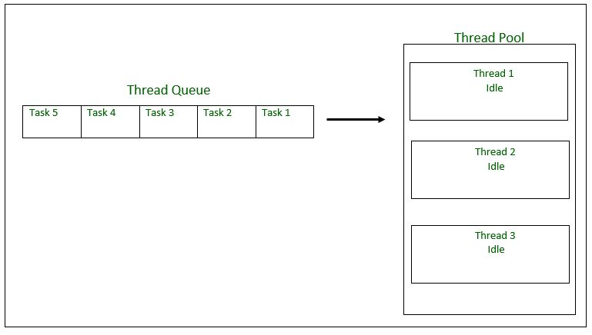
What is ThreadPool in Java?
Notes:
Lesson descriptions should be brief.

Slide 32
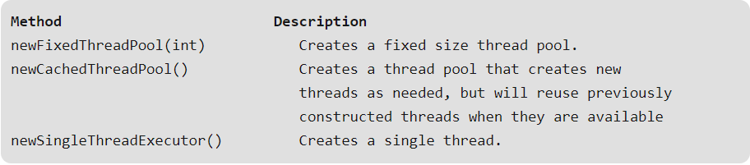
Executor Thread Pool Methods
In case of a fixed thread pool, if all threads are being currently run by the executor then the pending tasks are placed in a queue and are executed when a thread becomes idle.
Notes:
Lesson descriptions should be brief.

Slide 33
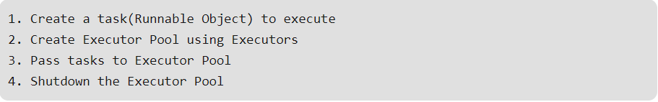
Thread Pool Example
In the following tutorial, we will look at a basic example of thread pool executor- FixedThreadPool.
Steps to be followed
Notes:
Lesson descriptions should be brief.

Slide 34

Thread Pool Example
Notes:
Lesson descriptions should be brief.

Slide 35
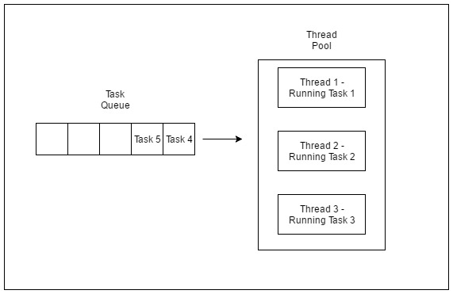
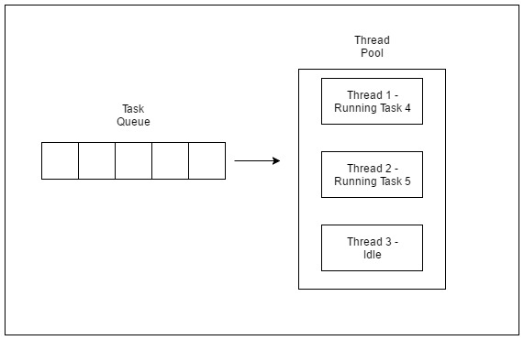
Thread Pool Example
As seen in the execution of the program, the task 4 or task 5 are executed only when a thread in the pool becomes idle. Until then, the extra tasks are placed in a queue.
Notes:
Lesson descriptions should be brief.

Slide 36
Risks in using Thread Pools
Deadlock : While deadlock can occur in any multi-threaded program, thread pools introduce another case of deadlock, one in which all the executing threads are waiting for the results from the blocked threads waiting in the queue due to the unavailability of threads for execution.
Thread Leakage :Thread Leakage occurs if a thread is removed from the pool to execute a task but not returned to it when the task completed. As an example, if the thread throws an exception and pool class does not catch this exception, then the thread will simply exit, reducing the size of the thread pool by one. If this repeats many times, then the pool would eventually become empty and no threads would be available to execute other requests.
Resource Thrashing :If the thread pool size is very large then time is wasted in context switching between threads. Having more threads than the optimal number may cause starvation problem leading to resource thrashing as explained.
Notes:
Lesson descriptions should be brief.

Slide 37
Important Points
Don’t queue tasks that concurrently wait for results from other tasks. This can lead to a situation of deadlock as described above.
Be careful while using threads for a long lived operation. It might result in the thread waiting forever and would eventually lead to resource leakage.
The Thread Pool has to be ended explicitly at the end. If this is not done, then the program goes on executing and never ends. Call shutdown() on the pool to end the executor. If you try to send another task to the executor after shutdown, it will throw a RejectedExecutionException.
One needs to understand the tasks to effectively tune the thread pool. If the tasks are very contrasting then it makes sense to use different thread pools for different types of tasks so as to tune them properly.
Notes:
Lesson descriptions should be brief.

Slide 38
Tuning Thread Pool
The optimum size of the thread pool depends on the number of processors available and the nature of the tasks.
On a N processor system for a queue of only computation type processes, a maximum thread pool size of N or N+1 will achieve the maximum efficiency.But tasks may wait for I/O and in such a case we take into account the ratio of waiting time(W) and service time(S) for a request; resulting in a maximum pool size of N*(1+ W/S) for maximum efficiency.
The thread pool is a useful tool for organizing server applications. It is quite straightforward in concept, but there are several issues to watch for when implementing and using one, such as deadlock, resource thrashing. Use of executor service makes it easier to implement.
Notes:
Lesson descriptions should be brief.

Slide 39
ThreadPoolExecutor
Java thread pool manages the pool of worker threads. It contains a queue that keeps tasks waiting to get executed. We can use ThreadPoolExecutor to create thread pool in Java.
Java thread pool manages the collection of Runnable threads. The worker threads execute Runnable threads from the queue. java.util.concurrent.Executors provide factory and support methods for java.util.concurrent.Executor interface to create the thread pool in java.
Executors is a utility class that also provides useful methods to work with ExecutorService, ScheduledExecutorService, ThreadFactory, and Callable classes through various factory methods.
Notes:
Lesson descriptions should be brief.

Slide 40
ThreadPoolExecutor
First, we need to have a Runnable class, named WorkerThread.java
package com.journaldev.threadpool;
public class WorkerThread implements Runnable {
private String command;
public WorkerThread(String s){
this.command=s;
}
@Override
public void run() {
System.out.println(Thread.currentThread().getName()+" Start. Command = "+command);
processCommand();
System.out.println(Thread.currentThread().getName()+" End.");
}
private void processCommand() {
try {
Thread.sleep(5000);
} catch (InterruptedException e) {
e.printStackTrace();
}
}
@Override
public String toString(){
return this.command;
}
}
Notes:
Lesson descriptions should be brief.

Slide 41
ExecutorService Example
Here is the test program class SimpleThreadPool.java, where we are creating fixed thread pool from Executors framework.
package com.journaldev.threadpool;
import java.util.concurrent.ExecutorService;
import java.util.concurrent.Executors;
public class SimpleThreadPool {
public static void main(String[] args) {
ExecutorService executor = Executors.newFixedThreadPool(5);
for (int i = 0; i < 10; i++) {
Runnable worker = new WorkerThread("" + i);
executor.execute(worker);
}
executor.shutdown();
while (!executor.isTerminated()) {
System.out.println("Finished all threads");
}
}
}
Notes:
Lesson descriptions should be brief.

Slide 42
ExecutorService Example
In the above program, we are creating a fixed-size thread pool of 5 worker threads.
Then we are submitting 10 jobs to this pool, since the pool size is 5, it will start working on 5 jobs and other jobs will be in wait state, as soon as one of the job is finished, another job from the wait queue will be picked up by worker thread and get’s executed.
Notes:
Lesson descriptions should be brief.

Slide 43
ExecutorService Example
pool-1-thread-2 Start. Command = 1
pool-1-thread-4 Start. Command = 3
pool-1-thread-1 Start. Command = 0
pool-1-thread-3 Start. Command = 2
pool-1-thread-5 Start. Command = 4
pool-1-thread-4 End.
pool-1-thread-5 End.
pool-1-thread-1 End.
pool-1-thread-3 End.
pool-1-thread-3 Start. Command = 8
pool-1-thread-2 End.
pool-1-thread-2 Start. Command = 9
pool-1-thread-1 Start. Command = 7
pool-1-thread-5 Start. Command = 6
pool-1-thread-4 Start. Command = 5
pool-1-thread-2 End.
pool-1-thread-4 End.
pool-1-thread-3 End.
pool-1-thread-5 End.
pool-1-thread-1 End.
Finished all threads
The output confirms that there are five threads in the pool named from “pool-1-thread-1” to “pool-1-thread-5” and they are responsible to execute the submitted tasks to the pool.
Notes:
Lesson descriptions should be brief.

Slide 44
ThreadPoolExecutor Example
Executors class provide simple implementation of ExecutorService using ThreadPoolExecutor but ThreadPoolExecutor provides much more feature than that.
We can specify the number of threads that will be alive when we create ThreadPoolExecutor instance and we can limit the size of thread pool and create our own RejectedExecutionHandler implementation to handle the jobs that can’t fit in the worker queue.
Here is our custom implementation of RejectedExecutionHandler interface.
package com.journaldev.threadpool;
import java.util.concurrent.RejectedExecutionHandler;
import java.util.concurrent.ThreadPoolExecutor;
public class RejectedExecutionHandlerImpl implements RejectedExecutionHandler {
@Override
public void rejectedExecution(Runnable r, ThreadPoolExecutor executor) {
System.out.println(r.toString() + " is rejected");
}
}
Notes:
Lesson descriptions should be brief.

Slide 45
ThreadPoolExecutor Example
ThreadPoolExecutor provides several methods using which we can find out the current state of the executor, pool size, active thread count and task count. So I have a monitor thread that will print the executor information at a certain time interval.
package com.journaldev.threadpool;
import java.util.concurrent.ThreadPoolExecutor;
public class MyMonitorThread implements Runnable
{
private ThreadPoolExecutor executor;
private int seconds;
private boolean run=true;
public MyMonitorThread(ThreadPoolExecutor executor, int delay)
{
this.executor = executor;
this.seconds=delay;
}
public void shutdown(){
this.run=false;
}
@Override
public void run()
{
while(run){
System.out.println(
String.format("[monitor] [%d/%d] Active: %d, Completed: %d, Task: %d, isShutdown: %s, isTerminated: %s",
this.executor.getPoolSize(),
this.executor.getCorePoolSize(),
this.executor.getActiveCount(),
this.executor.getCompletedTaskCount(),
this.executor.getTaskCount(),
this.executor.isShutdown(),
this.executor.isTerminated()));
try {
Thread.sleep(seconds*1000);
} catch (InterruptedException e) {
e.printStackTrace();
}
}
}
}
Notes:
Lesson descriptions should be brief.

Slide 46
ThreadPoolExecutor Example
Notice that while initializing the ThreadPoolExecutor, we are keeping initial pool size as 2, maximum pool size to 4 and work queue size as 2. So if there are 4 running tasks and more tasks are submitted, the work queue will hold only 2 of them and the rest of them will be handled by RejectedExecutionHandlerImpl.
On the side is the output of the above program that confirms the above statement.
Notice the change in active, completed and total completed task count of the executor. We can invoke shutdown() method to finish execution of all the submitted tasks and terminate the thread pool.
pool-1-thread-1 Start. Command = cmd0
pool-1-thread-4 Start. Command = cmd5
cmd6 is rejected
pool-1-thread-3 Start. Command = cmd4
pool-1-thread-2 Start. Command = cmd1
cmd7 is rejected
cmd8 is rejected
cmd9 is rejected
[monitor] [0/2] Active: 4, Completed: 0, Task: 6, isShutdown: false, isTerminated: false
[monitor] [4/2] Active: 4, Completed: 0, Task: 6, isShutdown: false, isTerminated: false
pool-1-thread-4 End.
pool-1-thread-1 End.
pool-1-thread-2 End.
pool-1-thread-3 End.
pool-1-thread-1 Start. Command = cmd3
pool-1-thread-4 Start. Command = cmd2
..
..
..
..
..
..
Notes:
Lesson descriptions should be brief.

Slide 47
Java 8 Parallel Stream
import java.util.Arrays;
import java.util.stream.IntStream;
public class Java8ParallelStreamMain {
public static void main(String[] args) {
System.out.println("=================================");
System.out.println("Using Sequential Stream");
System.out.println("=================================");
int[] array= {1,2,3,4,5,6,7,8,9,10};
IntStream intArrStream=Arrays.stream(array);
intArrStream.forEach(s->
{
System.out.println(s+" "+Thread.currentThread().getName());
}
);
System.out.println("=================================");
System.out.println("Using Parallel Stream");
System.out.println("=================================");
IntStream intParallelStream=Arrays.stream(array).parallel();
intParallelStream.forEach(s->
{
System.out.println(s+" "+Thread.currentThread().getName());
}
);
}
}
Java 8 introduces the concept of parallel stream to do parallel processing.
As we have more number of cpu cores nowadays due to cheap hardware costs, parallel processing can be used to perform operation faster.
Let’s understand with help of simple example
Notes:
Lesson descriptions should be brief.

Slide 48
Java 8 Parallel Stream
When you run above program, you will get below output
================================= Using Sequential Stream ================================= 1 main 2 main 3 main 4 main 5 main 6 main 7 main 8 main 9 main 10 main
================================= Using Parallel Stream ================================= 7 main 6 ForkJoinPool.commonPool-worker-3 3 ForkJoinPool.commonPool-worker-1 9 ForkJoinPool.commonPool-worker-2 2 ForkJoinPool.commonPool-worker-3 5 ForkJoinPool.commonPool-worker-1 10 ForkJoinPool.commonPool-worker-2 1 ForkJoinPool.commonPool-worker-3 8 ForkJoinPool.commonPool-worker-2 4 ForkJoinPool.commonPool-worker-1
Notes:
Lesson descriptions should be brief.

Slide 49
Java 8 Parallel Stream
If you notice the output,main thread is doing all the work in case of sequential stream.It waits for current iteration to complete and then work on next iteration.
In case of Parallel stream,4 threads are spawned simultaneously and it internally using Fork and Join pool to create and manage threads.Parallel streams create ForkJoinPool instance via static ForkJoinPool.commonPool() method.
Parallel Stream takes benefits of all available CPU cores and processes the tasks in parallel. If number of tasks exceeds the number of cores, then remaining tasks wait for currently running task to complete.
Notes:
Lesson descriptions should be brief.

Slide 50
Parallel Streams are cool, so should you use it always?
A big No!!
It is easy to convert sequential Stream to parallel Stream just by adding .parallel, does not mean you should always use it.
There are lots of factors you need to consider while using parallel streams otherwise you will suffer from negative impacts of parallel Streams.
Parallel Stream has much higher overhead than sequential Stream and it takes good amount of time to coordinate between threads.
Notes:
Lesson descriptions should be brief.

Slide 51
Parallel Streams are cool, so should you use it always?
You need to consider parallel Stream if and only if:
You have large dataset to process.
As you know that Java uses ForkJoinPool to achieve parallelism, ForkJoinPool forks sources stream and submit for execution, so your source stream should be splittable. For example: ArrayList is very easy to split, as we can find a middle element by its index and split it but LinkedList is very hard to split and does not perform very well in most of the cases.
You are actually suffering from performance issues.
You need to make sure that all the shared resources between threads need to be synchronized properly otherwise it might produce unexpected results.
Notes:
Lesson descriptions should be brief.

Slide 52
What is CompletableFuture?
A CompletableFuture is used for asynchronous programming. Asynchronous programming means writing non-blocking code. It runs a task on a separate thread than the main application thread and notifies the main thread about its progress, completion or failure.
In this way, the main thread does not block or wait for the completion of the task. Other tasks execute in parallel. Parallelism improves the performance of the program.
A CompletableFuture is a class in Java. It belongs to java.util.cocurrent package. It implements CompletionStage and Future interface.
Notes:
Lesson descriptions should be brief.

Slide 53
CompletionStage
It performs an action and returns a value when another completion stage completes.
A model for a task that may trigger other tasks.
Hence, it is an element of a chain.
When more than one thread attempt to complete - complete exceptionally or cancel a CompletableFuture, only one of them succeeds.
Notes:
Lesson descriptions should be brief.

Slide 54
Future vs. CompletableFuture
A CompletableFuture is an extension to Java's Future API which was introduced in Java 8.
A Future is used for asynchronous Programming. It provides two methods, isDone() and get(). The methods retrieve the result of the computation when it completes.
Notes:
Lesson descriptions should be brief.

Slide 55
Limitations of the Future
A Future cannot be mutually complete.
We cannot perform further action on a Future's result without blocking.
Future has not any exception handling.
We cannot combine multiple futures.
Future has so many limitations, that's why we have CompletableFuture. CompletableFuture provides a broad set of methods for creating multiple Futures, chaining, and combining.
It also has comprehensive exception handling support.
Notes:
Lesson descriptions should be brief.

Slide 56
Creating a CompletableFuture
We can create a CompletableFuture only by using the following no-argument constructor.
CompletableFuture<String> CompletableFuture = new CompletableFuture<String>();
Notes:
Lesson descriptions should be brief.

Slide 57
Example CompletableFuture
The most frequently used CompletableFuture methods are:
supplyAsync(): It complete its job asynchronously. The result of supplier is run by a task from ForkJoinPool.commonPool() as default. The supplyAsync() method returns CompletableFuture on which we can apply other methods.
thenApply(): The method accepts function as an arguments. It returns a new CompletableStage when this stage completes normally. The new stage use as the argument to the supplied function.
join(): the method returns the result value when complete. It also throws a CompletionException (unchecked exception) if completed exceptionally.
Notes:
Lesson descriptions should be brief.

Slide 58
Example CompletableFuture
import java.util.Arrays;
import java.util.List;
import java.util.concurrent.CompletableFuture;
public class CompletableFutureExample1
{
public static void main(String[] args)
{
try
{
List<Integer> list = Arrays.asList(5,9,14);
list.stream().map(num->CompletableFuture.supplyAsync(()->getNumber(num))).map(CompletableFuture->CompletableFuture.thenApply(n-
>n*n)).map(t->t.join()).forEach(s->System.out.println(s));
}
catch (Exception e)
{
e.printStackTrace();
}
}
private static int getNumber(int a)
{
return a*a;
}
}
Notes:
Lesson descriptions should be brief.

Slide 59
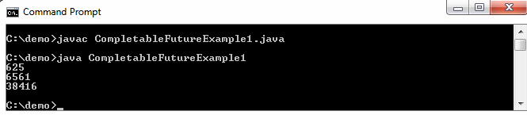
Example CompletableFuture
Notes:
Lesson descriptions should be brief.

Slide 60
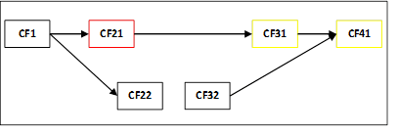
Exception Handling of CompletableFuture
Consider the following figure, which represents the five CFs:
Suppose Five CFs in execution and CF21 raises an exception then all the depending CF (CF31 and CF41) are in error. It means that:
The call to isCompletedExceptionally() method returns true.
The call to get() throws an ExecutionException which causes the root Exception.
Notes:
Lesson descriptions should be brief.

Slide 61
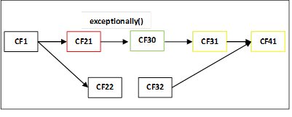
Exception Handling of CompletableFuture
Consider the following figure, in which we have created CF30 with an exception.
When CF21 executes normally, then CF30 just transmits the value. If it raises an exception, CF30 handles it and generate value for CF31.
Notes:
Lesson descriptions should be brief.

Slide 62
Exception Handling of CompletableFuture
There are three method to handle an exception:
public CompletableFuture <T> exceptionally(Function <Throwable, ? extends T> function);
public <U> CompletableFuture<U> hadle(BiFunction<? super T, Throwable, ? extends U> bifunction);
public CompletableFuture<T> whenComplete(BiConsumer<? super T, ? super Throwable> action);
Notes:
Lesson descriptions should be brief.

Slide 63


